Slide 1


Mastering Your Day: The Ultimate To-Do List Guide
Welcome to our guide on mastering your day. We will explore effective strategies. You will learn to conquer your to-do list. Achieve peak productivity and peace of mind.
by S GOWDA

Slide 2
The Psychology Behind Procrastination: Understanding Your Resistance
Why We Procrastinate
Overcoming the Urge
Procrastination often stems from fear. It can be fear of failure or success. Overwhelm is also a common trigger. We delay tasks due to their perceived difficulty.
Break tasks into smaller steps. Focus on starting, not finishing. Reward yourself for progress. Understand your triggers to fight them effectively.

Slide 3
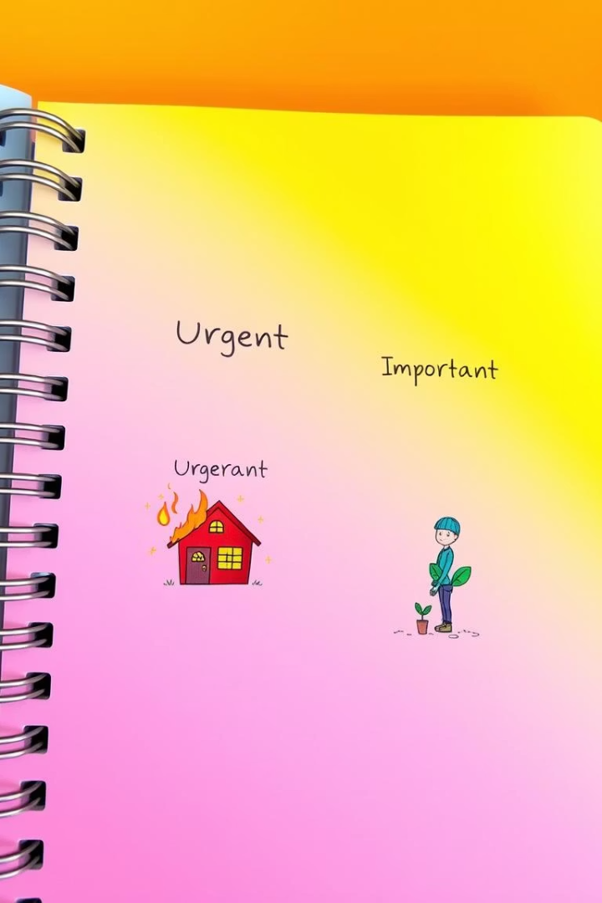
Defining Your Priorities: Urgent vs. Important
Urgent Tasks
These demand immediate attention. They often have strict deadlines. They can create a sense of crisis. Address them quickly to avoid issues.
Important Tasks
These contribute to long-term goals. They may not have tight deadlines. They are crucial for future success. Prioritize them for significant impact.

Slide 4
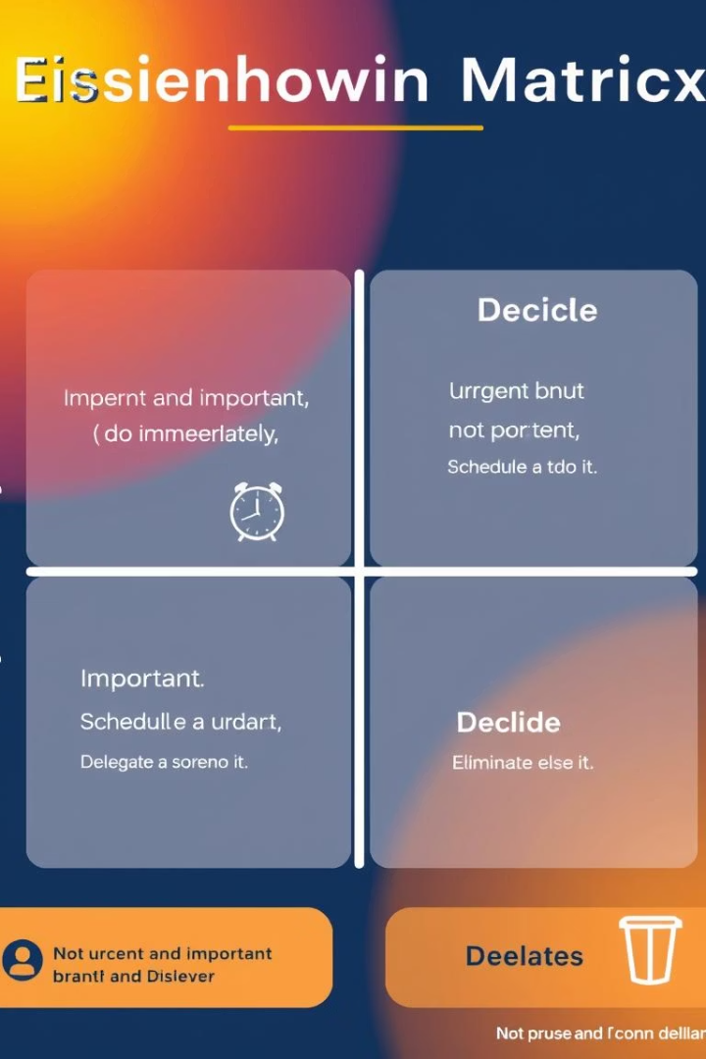
The Eisenhower Matrix: A Powerful Prioritization Tool
Urgent
Not Urgent
Important
Do First
Schedule
Not Important
Delegate
Eliminate
The Eisenhower Matrix helps categorize tasks. It sorts them by urgency and importance. This tool promotes clear decision-making. It ensures focus on high-impact activities. Prioritize your actions wisely.

Slide 5
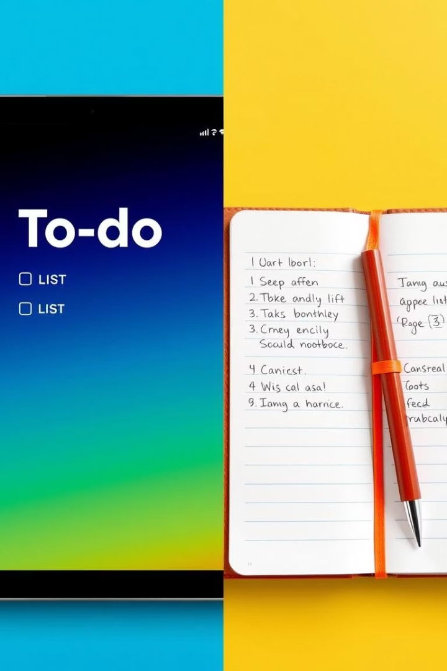


Digital vs. Analog: Choosing the Right To-Do List Format
Digital Benefits
Analog Advantages
Digital tools offer flexibility. They provide sync across devices. You can easily reorder and track tasks. Notifications help keep you on track.
Writing by hand improves memory. It offers a tangible sense of accomplishment. Analog lists reduce screen time. They provide a distraction-free experience.

Slide 6
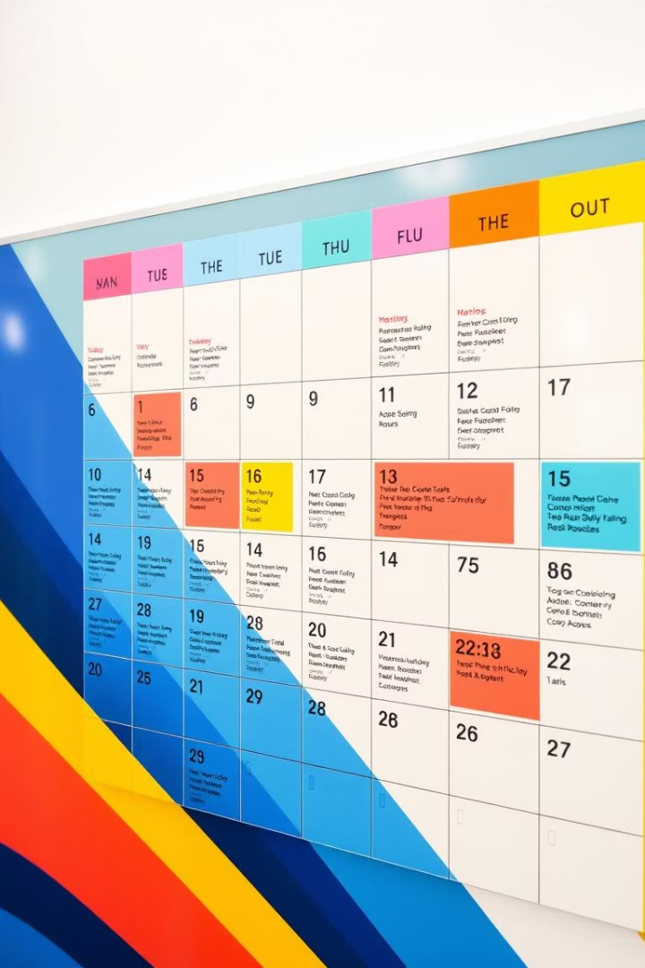



Time Blocking Techniques: Scheduling for Success
Allocate Time
Assign specific time slots. Dedicate them to particular tasks. This prevents multitasking errors.
Focus Deeply
Work without interruptions. Maximize concentration on one task. Achieve more in less time.
Review Progress
Regularly check your schedule. Adjust as needed throughout the day. Stay aligned with your goals.

Slide 7




Task Batching: Streamlining Similar Activities
Group Similar Tasks
Minimize Switching Costs
Combine related activities. Process emails together. Make all phone calls at once. This reduces context switching.
Avoid frequent task changes. Switching tasks wastes mental energy. Stay in flow for longer periods.
Boost Efficiency
Batching increases productivity. You gain momentum on similar tasks. Complete more in less time.

Slide 8

Review and Reflect: Optimizing Your Workflow
Continuous Improvement
Weekly Reflection
Refine your process. Experiment with new methods. Optimize your workflow over time. Strive for constant growth.
Daily Review
Assess overall progress. Identify successes and challenges. Adjust strategies if needed. Learn from your experiences.
Check completed tasks. Update your to-do list. Plan for the next day. This keeps you organized.

